Slide 1
Research Transparency
Sharing of Workshop Learnings
March 2017

Slide 2
1
Sample Title Sheet
1 I © Athena Infonomics 2015
Notes:
As we are trying to minimise the number of slides, this Slide can be dropped.

Slide 3
Slide Title
Heading 1
Sub Heading
Sub Heading
2 I © Athena Infonomics 2015

Slide 4
Overview of Research Transparency and Reproducibility
Introduction to Research Transparency and Reproducibility
Registration and Pre-Analysis Plans
Coding Reproducibility
Data De-Identification and Sharing
Replication and Data Sharing Activity

Slide 5

Version Control
Github lets you store your projects and manage different versions of it.
Time to get acquainted with Github lingo
Cloning, Creating & Adding
Adding is finding and telling the app that a repository is already on your computer.
Creating creates a new repository.
Cloning is copying an existing repository from your GitHub account
Forking
Producing a personal copy of someone else's project.
Q. But how is it really useful?
A. You can submit Pull Requests to improve somebody else’s project
Now, let’s fork something! →
Notes:
lets you and others work together on projects from anywhere
Command line version & GitHub Desktop
Text-editor Atom, Github Desktop app, create account
The aspirational goal is that I should be able to sneak into your lab late at night, delete everything except for your raw data and your code, and you should be able to run a single command to regenerate EVERYTHING, including all of your results, tables, and figures in their final, polished form. Think of this as the “push button” or "one click" workflow.
the upsides are:
Never ever accidentally deleting or otherwise losing a file
Always being able to revert to your last working pipeline
Easy to discover what has changed (i.e. gone wrong), and when
Fork a repository (spoon fork) (delete 1st)
Clone a repository, create a folder, add a repository.
After creating a folder, show it to them on explorer

Slide 6
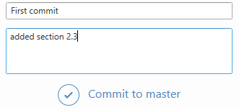
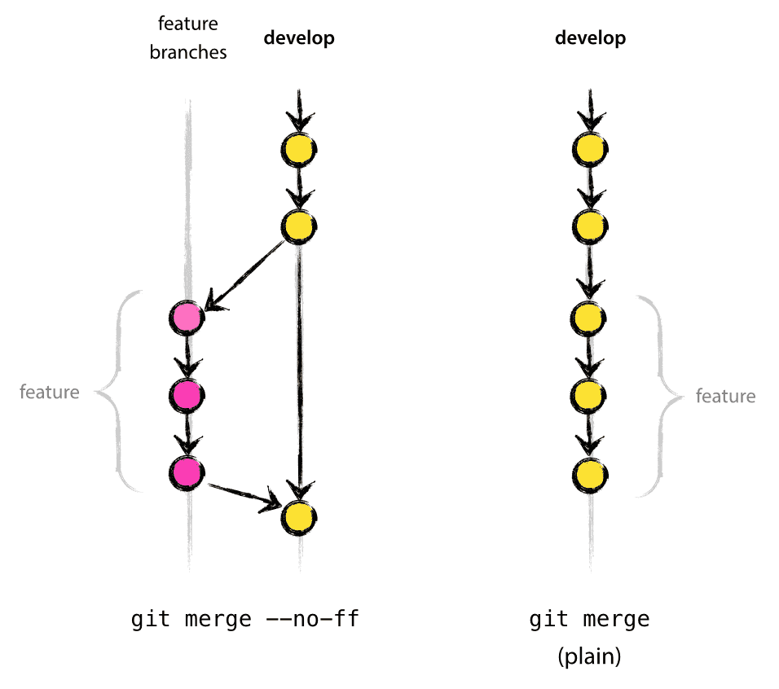
Version Control (contd.)
Don’t be scared of committing!
What is a commit?
Individual change to a file (or set of files). It's like when you save a file
A commit shows you each version of a document and exactly what change you have made
You can revert a commit (revert=undo)
Time to branch out..
A branch represents an independent line of development.
Same project, but you’re branching out to try something different
For instance, you’re trying a logistic model instead of LPM
Merge the branch if you’re happy with it
2 I © Athena Infonomics 2015
Notes:
Command line version & GitHub Desktop
Text-editor Atom, Github Desktop app, create account
The aspirational goal is that I should be able to sneak into your lab late at night, delete everything except for your raw data and your code, and you should be able to run a single command to regenerate EVERYTHING, including all of your results, tables, and figures in their final, polished form. Think of this as the “push button” or "one click" workflow.
the upsides are:
Never ever accidentally deleting or otherwise losing a file
Always being able to revert to your last working pipeline
Easy to discover what has changed (i.e. gone wrong), and when

Slide 7
Version Control (contd.)
Get ready to push and pull!
Pushing
Sends your changes up to GitHub, so they can be shared with your partner(if it’s a private repository) or the rest of the world (if it’s public).
Pulling
Retrieves changes from the remote location and applies them to your local repository
More useful in a group environment where more than one person is submitting changes to a single repository
But why is Github better than MS Word +Track changes?
Track changes does not keep track of different versions of the document
If you and your partner decide that version 4 was better than version 5- you can exactly go back to version 4
If you’ve sent a first draft to your manager for her approval, you can both work on the document at the same time
Notes:
Command line version & GitHub Desktop
Text-editor Atom, Github Desktop app, create account
The aspirational goal is that I should be able to sneak into your lab late at night, delete everything except for your raw data and your code, and you should be able to run a single command to regenerate EVERYTHING, including all of your results, tables, and figures in their final, polished form. Think of this as the “push button” or "one click" workflow.
the upsides are:
Never ever accidentally deleting or otherwise losing a file
Always being able to revert to your last working pipeline
Easy to discover what has changed (i.e. gone wrong), and when

Slide 8
Dynamic Documents using Stata, R, SAS
Slide Text
2 I © Athena Infonomics 2015

Slide 9
PHASE | KEY ACTIVITIES | TOOLS | OUTPUT
PHASE 1:
DATA COLLECTION
Amazon to provide internal data needed for relevant sections of report
Stratified random sampling technique to be used among customer and seller stakeholder groups
Developing a questionnaire and survey design
Conducting interviews with identified stakeholders
Secondary Research
300 customer interviews
300 seller interviews
5 FCs to be surveyed, 5 logistics team including women only teams will be interviewed
IDIs with Capital First & Yes Bank to understand impact on financial sector
IDIs with key policymakers and competitor organisations
Online surveys, Face to Face & Telephonic Interviews
PHASE 2:
ANALYSIS
Data cleaning and review
Internal consistency checks
Content analysis of qualitative responses
Descriptive statistics
Estimating relevant forecasts
MS Excel
Robust data identifying Amazon’s impact on different sectors as well capability to forecast growth channels for Amazon
Characteristics of prevailing economic environment for ecommerce, the underlying key challenges and identifying work areas
Interaction with expert advisors
2 I © Athena Infonomics 2015
PHASE 3:
OUTPUT
Compile the final report supplemented with case studies
Findings from quantitative and qualitative data
Report that documents economic opportunities Amazon has created thus far as well as the path of the future growth that it is helping to unlock.
Interaction with expert advisors

